Slide 1
第4章 数据处理
1. P2P Lookup
2. Replication and Consistency
参考文献：
Tanenbaum, Chapter 7 Consistency and Replication
CDK5, Chapter 18 Replication

Slide 2
2. Replication and Consistency

Slide 3
1. Introduction to Replication
Two Reasons for Replication:
Reliability & availability
keep working after one replica crashes, increasing system availability
protect against accessing corrupted data
Performance
reduce latency in data access
scale in number and geographical area
Price for Replication:
Costs of storage and communication
Replication → Consistency: globe synchronize or relax consistency constrains

Slide 4
CAP Conjecture
In 2000, Eric Brewer (PODC 2000) states that it is impossible for a distributed computer system to simultaneously provide all three of the following guarantees:
Consistency (all nodes see the same data at the same time)
Availability (a guarantee that every request receives a response about whether it was successful or failed)
Partition tolerance (the system continues to operate despite arbitrary message loss)
In 2002, Seth Gilbert and Nancy Lynch of MIT published a formal proof of Brewer's conjecture, establishing it as a theorem.
Seth Gilbert and Nancy Lynch, Brewer's conjecture and the feasibility of consistent, available, partition-tolerant web services, ACM SIGACT News, Volume 33 Issue 2, 2002

Slide 5
CAP Examples
Amazon Dynamo
Dynamo: Amazon’s Highly Available Key-value Store, 2007
Gossip-based membership protocol
C: eventual consistency
A: data replication with (N, R, W)
Quorum-based: R+W>N
P: consistent hashing
Facebook/Apache Cassandra
Cassandra: a decentralized structured storage system, 2010
C: eventual consistency
Gossiping
A: data replication with (N, R, W)
Quorum-based: R+W>N
P: DHT

Slide 6
Outline
Consistency Models
2. Data-centric consistency models
3. Client-centric consistency models
Implementation of Replication
4. Replica management
Replica-server placement
Content replication and placement
Content distribution
5. Consistency Protocols
Primary-based protocols
Replicated-write protocols
Case study: Raft

Slide 7
2. Data-centric Consistency Models
A consistency model is a contract between processes and the data store which says if processes agree to obey certain rules, the store promises to work correctly.
Normally, a process that performs a read operation on a data item expects the operation to return a value that shows the results of the last write operation on that data
Strict consistency/Strong consistency
Weak consistency
Sequential consistency
Causal consistency
Entry consistency
Eventual consistency

Slide 8

Sequential Consistency
The result of any execution is the same as if the (read and write) operations by all processes on the data store were executed in some sequential order and the operations of each individual process appear in this sequence in the order specified by its program.
A sequentially consistent data store.
A data store that is not sequentially consistent.
Where W(x)a stands for a write by process P to data item x with the value a and R(x)b stands for a read from data item x by P returning b.

Slide 9


Causal Consistency
Writes that are potentially casually related must be seen by all processes in the same order
Concurrent writes may be seen in a different order on different machines
concurrent
This sequence is allowed with a causally-consistent store, but not with sequentially consistent store.
depending on
concurrent
A violation of a casually-consistent store.
A correct sequence of events in a casually-consistent store.
Notes:
实时协同编辑，协同计算；例如：Eclipse，插件，Jupiter做代码review

Slide 10
Entry Consistency (1)
A group of operations are bracketed by the pair of operations Acquire and Release:
Acquire: enter a critical region, acquire relevant synchronization variables
Release: exit a critical region, release relevant synchronization variables
Owner of synchronization variable is the process that acquires the variable
A data store exhibits entry consistent, if it obeys the following rules:
An acquire access of a synchronization variable is not allowed to perform with respect to a process until all updates to the guarded shared data have been performed with respect to that process
Before an exclusive mode access to a synchronization variable by a process is allowed to perform with respect to that process, no other process may hold the synchronization variable, not even in nonexclusive mode
After an exclusive mode access to a synchronization variable has been performed, any other process's next nonexclusive mode access to that synchronization variable may not be performed until it has performed with respect to that variable's owner

Slide 11

Entry Consistency (2)
A valid event sequence for entry consistency.
The user cannot feel the existing of entry consistency while using of distributed shared objects.
client calls distributed objects → acquires synchronized objects → copies the newest object to client → releases lock after finishing method

Slide 12
Other Consistency
Eventual Consistency
If no updates take place for a long time, all replicas will gradually become consistent
Tolerate a relatively high degree of inconsistency
Metrics for defining inconsistencies:
(numerical deviation) deviation in numerical values between replicas
an absolute numerical deviation, a relative numerical deviation
in terms of the number of updates that have been applied to a given replica, but have not yet been seen by others. In a form of (value, weight) in the next page.
deviation in staleness between replicas
(ordering deviation) deviation with respect to the ordering of update operations

Slide 13
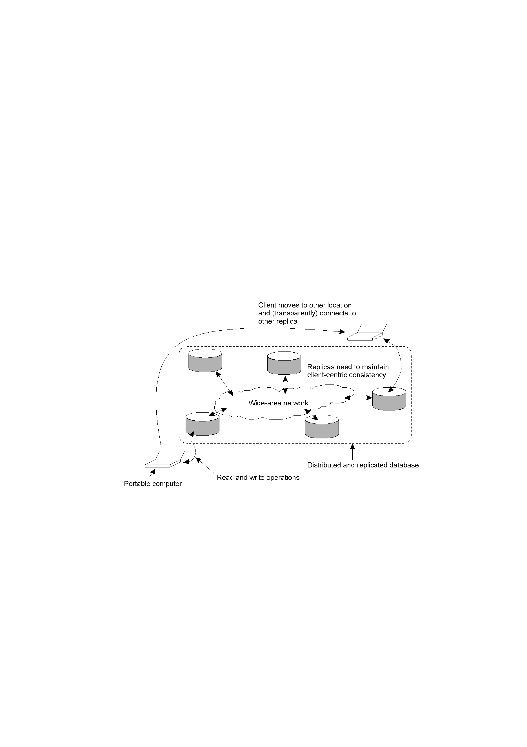
3. Client-centric Consistency Models
Scenarios: Some data stores have few simultaneous updates. The question needed to be solved is how fast the updates are made available to only-reading processes.
For an eventual consistent data store, client-centric consistency provides guarantees for a single client concerning the consistency of accesses to a data store by that client.
Monotonic-read consistency
Monotonic-write consistency
Read-your-writes consistency
Writes-follow-reads consistency

Slide 14
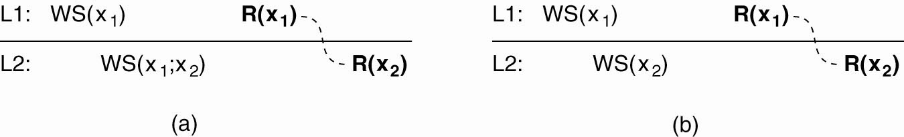
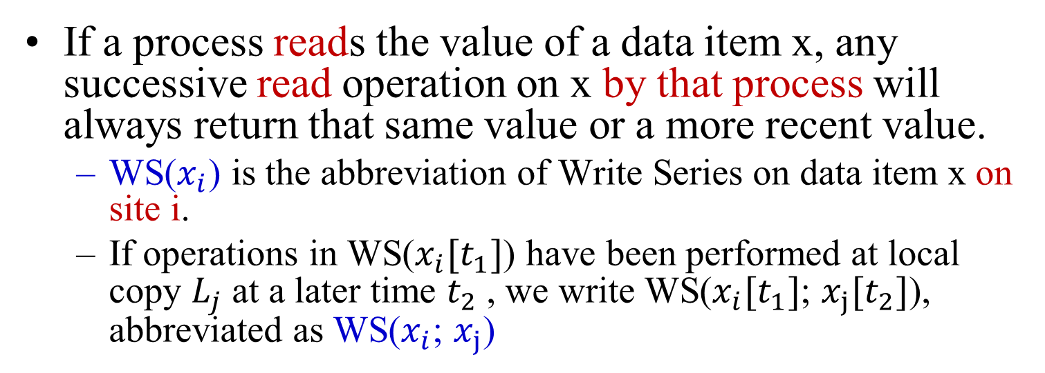
Monotonic Read Consistency
If a process reads the value of a data item x, any successive read operation on x by that process will always return that same value or a more recent value.
WS($x_{i}$) is the abbreviation of Write Series on data item x on site i.
If operations in WS($x_{i}[t_{1}]$) have been performed at local copy $L_{j}$ at a later time $t_{2}$, we write WS($x_{i}[t_{1}]$; $x_{j}[t_{2}]$), abbreviated as WS($x_{i}$; $x_{j}$)
The read operations performed by a single process P at two different local copies of the same data store.
A monotonic-read consistent data store
A data store that does not provide monotonic reads.

Slide 15
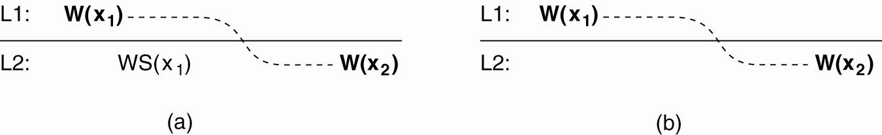
Monotonic Writes Consistency
A write operation by a process on a data item x is completed before any successive write operation on x by the same process.
The write operations performed by a single process P at two different local copies of the same data store
A monotonic-write consistent data store.
A data store that does not provide monotonic-write consistency.

Slide 16
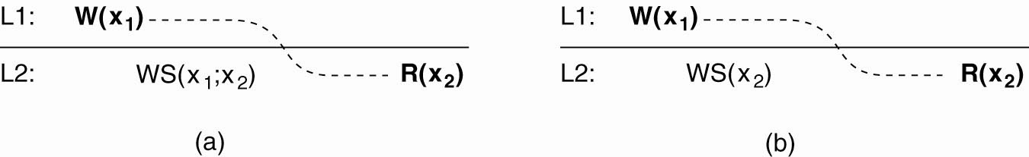
Read Your Writes Consistency
The effect of a write operation by a process on data item x will always be sent by a successive read operation on x by the same process.
A data store that provides read-your-writes consistency.
A data store that does not.

Slide 17

Writes Follow Reads Consistency
A write operation by a process on a data item x following a previous read operation on x by the same process, is guaranteed to take place on the same or a more recent value of x that was read.
A writes-follow-reads consistent data store
A data store that does not provide writes-follow-reads consistency

Slide 18
4. Replica Management
Replica-server placement: find the best locations to place a server that can host a data store
Content replication and placement: find the best servers for placing content
Permanent Replicas: place in advance
Server-initiated Replicas
Client-initiated Replicas: client caches
Content distribution/Update propagation
States versus Operations
Pull versus Push Protocols
Unicasting, Multicasting, or Epidemic Protocols

Slide 19
Replica-server Placement
An optimization problem in which the best K out of N locations need to be selected (K<N)
Several heuristic algorithms:
(distance) Select one server at a time such that the average distance (in terms of latency or bandwidth) between the server and its clients is minimal
(topology) Place a server on the router with the largest number of network link in an autonomous system (AS)
An AS can be viewed as a network running the same routing protocol and managed by a single organization
(region) Select the most demanding regions, and let one of the nodes in such a region act as replica server
Region: a collection of nodes accessing the same content, but for which the inter-node latency is low
Identify the K largest clusters and assign a node from each cluster to host replicated content

Slide 20
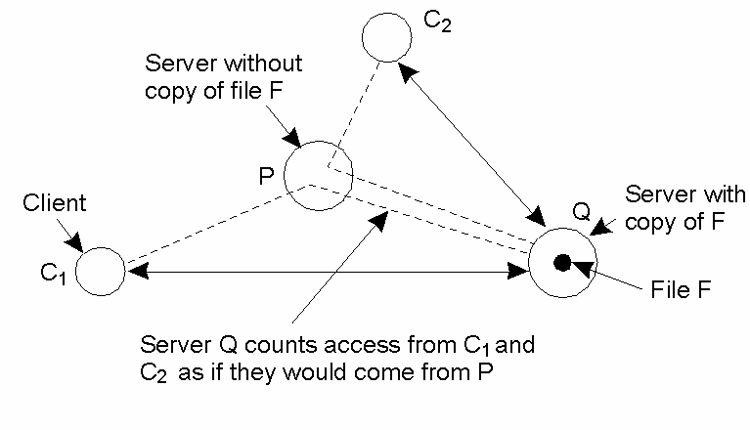
Server-initiated Replicas
Target Environment: rarely-modified data store, e.g., in Web hosting services which replicate files to servers close to demanding clients
How to migrate or replicate specific files on a server to servers in the proximity of demanding clients?
For a specific file F at server Q:
count_{Q}(P,F), P is the closest server to the client visiting F
rep(Q,F), replication threshold
del(Q,F), deletion threshold
count_{Q}(P,F)
Counting access requests from different clients.

Slide 21
Client-initiated Replicas/Client Caches
Placement of client caches:
A cache is placed on the same machine as its client or a machine (in a cluster) shared by clients on the same local-area network
Place cache servers at specific points in a wide-area network, let a client locate the nearest server
Distributed cache system
Metrics:
Invalidation time of cached data items
Cache hit

Slide 22
Content Distribution: States versus Operations
Propagate only a notification of an update
Invalidation protocol: specify which part of the data store has been updated, and update the copy first whenever an operation on an invalidated copy is requested
Transfer modified data from one copy to another, especially, to save bandwidth,
Transfer only changes, or
Pack multiple modifications into a single message
Propagate the update operation to other copies
Assuming each replica is capable of actively keeping its associated data up to date by performing operations

Slide 23
Content Distribution: Pull versus Push Protocols
Push-based: updates are propagated to other replicas without those replicas even asking for the updates.
Pull-based: a server or client requests another server to send it any updates it has.
 | Push-based | Pull-based
State of server | List of client replicas and caches | None
Messages sent | Update (and possibly fetch update later) | Poll and update
Response time at client | Immediate (or fetch-update time) | Fetch-update time
A comparison between push-based and pull-based protocols in the case of multiple-client, single-server systems.

Slide 24
Hybrid Form of Pull and Push Protocols
A lease is a promise by the server that it will push updates to the client for a specified time.
Within the lease, server push updates
When the lease expires, the client is forced to poll the server for updates, or requests a new lease for pushing updates
Ways to dynamic adapt the expiration time:
Depending on the last time data was modified: Age-based leases
Depending on the frequency a client requests its cached copy to be updated: Renewal-frequency leases
Depending on the state-space overhead

Slide 25
Content Distribution: Unicasting vs. Multicasting
Unicasting: send N separate messages to N servers, one to each server, often combined with a pull-based approach to propagating updates
Multicasting: send updating message with multicast supported by underlying network, often combined with a push-based approach
Epidemic Protocols: implement update propagation in eventual consistent data stores

Slide 26
5. Consistency Protocols
Primary-based protocols: each data item x has an associated primary responsible for coordinating write operations on x.
Replicated-write protocols: multiple replicas can carry write operations.
Case study: Raft
Implementing client-centric consistency

Slide 27
5.1 Primary-Based Protocols
Primary-based protocols: each data item has an associated primary responsible for coordinating write operations.
Remote-Write Protocols, i.e., Primary Backup Protocols: perform read operations on a locally available copy, but should forward write operations to a fixed primary copy
Local-Write Protocols: moving the primary to the process where the write operation is initiated

Slide 28
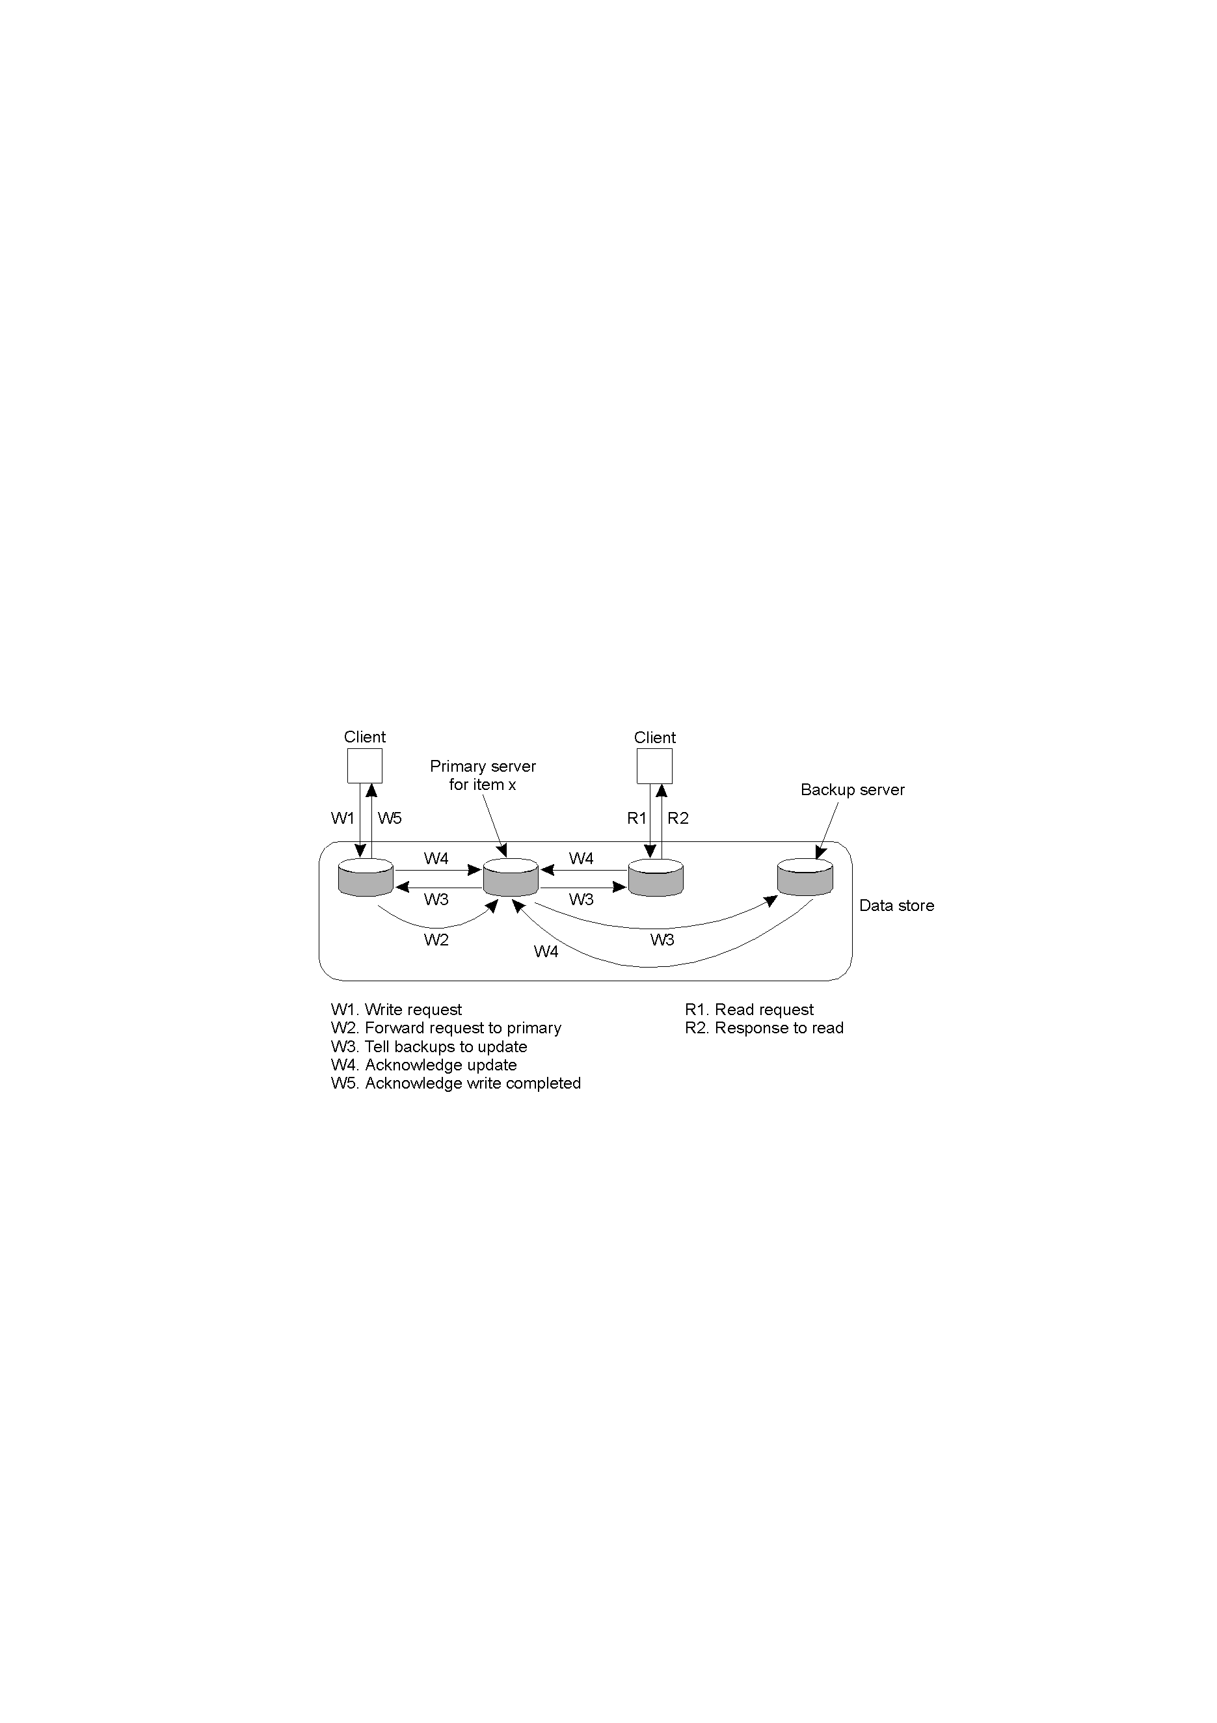
Primary-Based Protocols: Primary-Backup Protocols
The principle of primary-backup protocol which provides a straightforward implementation of sequential consistency.
Blocking version vs. Non-blocking version

Slide 29
Primary-Backup System
A primary-backup system implements the sequence consistency if the primary is correct, since the primary sequences all the operations upon the shared objects.
If the primary fails, then the system retains the sequence consistency if a single backup becomes the new primary (by election) and if the new system configuration takes over exactly where the last left off
Methods: the primary uses view-synchronous group communication to send the updates to the backups; the primary broadcasts heartbeat messages
view-synchronous group communication implements reliable group communication with dynamic groups in the presence of failures
Given that at most m servers can fail over a given time and considering only crash failure, at least (m+1) replicas are sufficient to tolerate the crash of m servers, the smallest failover time is τ+2δ+T, where τ is the interval between the reception of two consecutive heartbeat messages, T is the election time, and δ is the maximum message propagation delay from the primary to a backup server

Slide 30
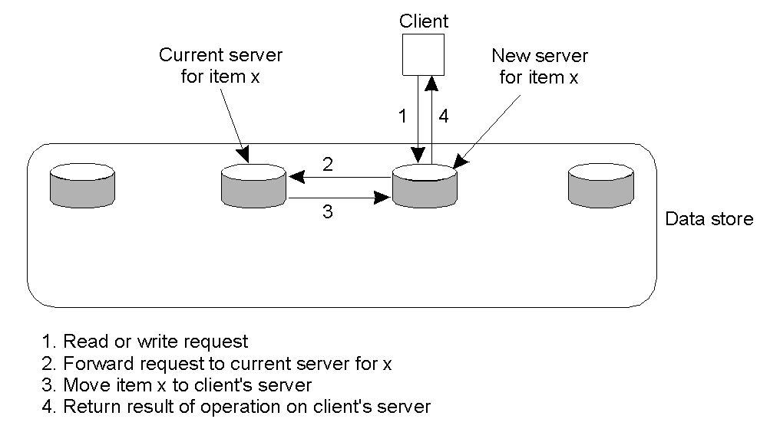
Primary-Based Protocols: Local-Write Protocols (1)
A kind of local-write protocol is the one in which a single copy is migrated between processes.
How to locate the data with this fully migrating approach? Name service

Slide 31
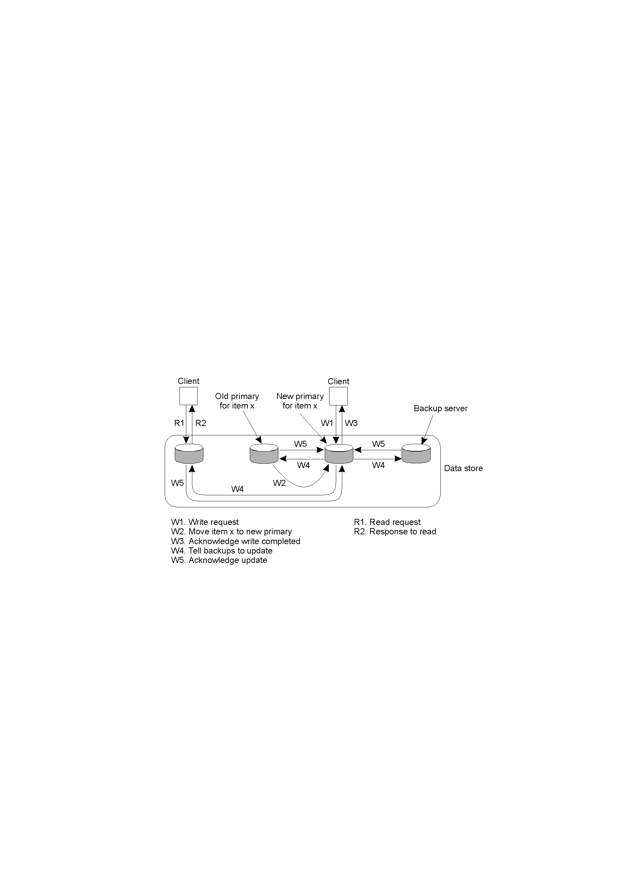
Primary-Based Protocols: Local-Write Protocols (2)
Another kind of local-write protocol is the one in which the primary migrates to the process that wish to perform a write operation.
Multiple replicas
Non-blocking version for propagate updates to the replicas: a fixed central server may be adopted
It is applicable to mobile computers working in a disconnected mode.

Slide 32
5.2 Replicated-Write Protocols
Replicated-write protocols: multiple replicas can carry write operations.
Active Replication: forward an operation to all replicas
Quorum-Based Protocols: based on majority voting

Slide 33
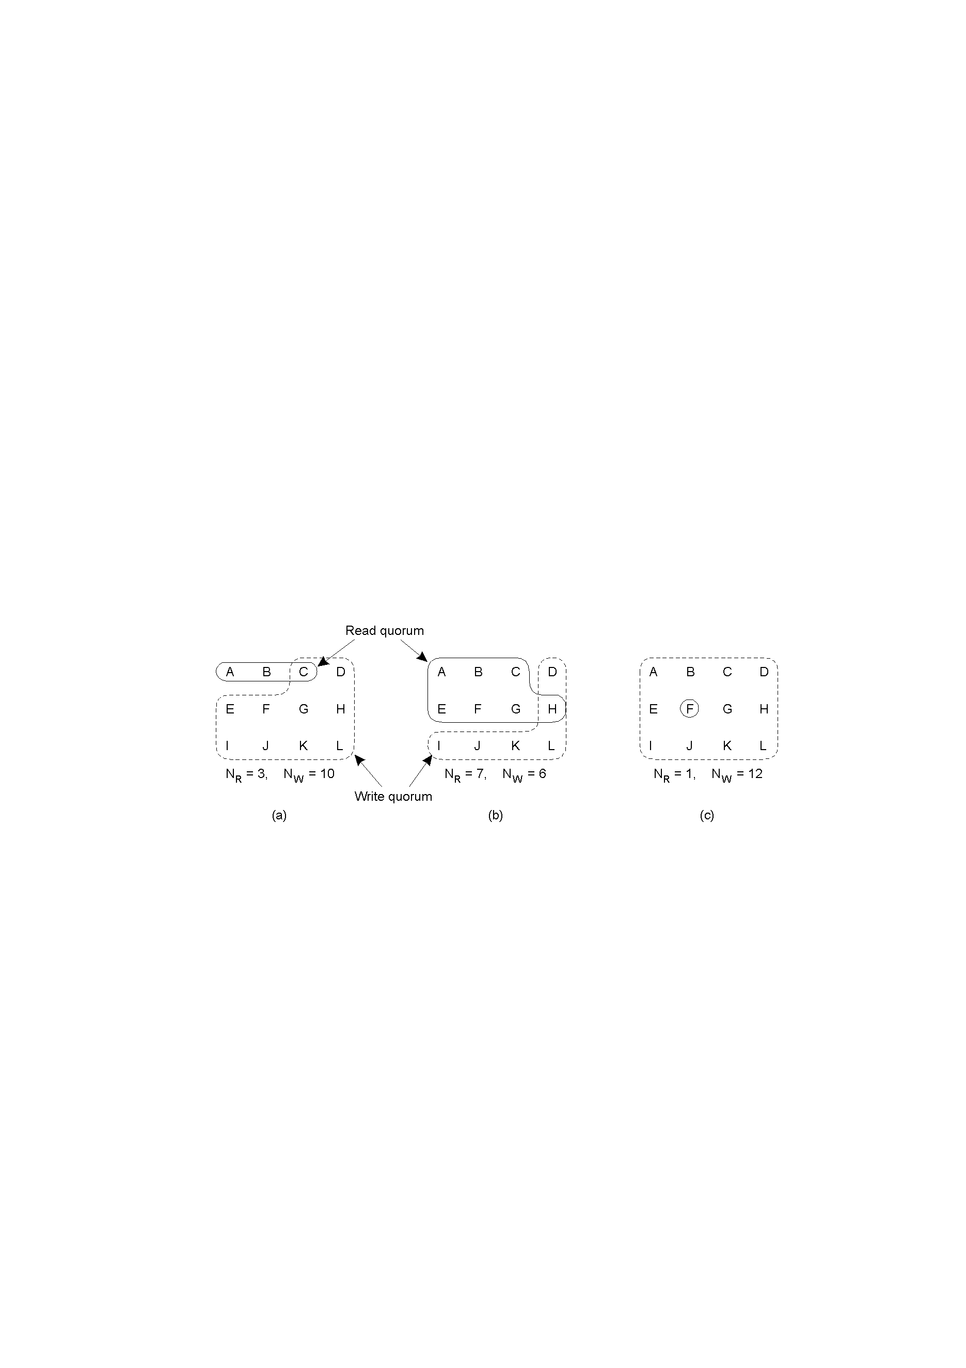
Replicated-Write Protocols: Quorum-Based Protocols
N replicas exist, reading a file needs a read quorum, an arbitrary collection of any NR servers, or more.
Modifying a file require a write quorum of at least Nw servers.
NR+NW>N avoid r-w conflict NW>N/2 avoid w-w conflict
Three examples of the voting algorithm:
A correct choice of read and write set
A choice that may lead to write-write conflicts
A correct choice, known as ROWA (read one, write all)

Slide 34
Replicated-Write Protocols: Active Replication (1)
Forwarding a write operation to multiple replicas.
The problem of replicated invocations:
ensure the operations need to be carried out in the same order everywhere
Agreement: Every correct replica receives all the requests.
Order (and Stability): Every correct replica receives the operation requests in the same order. (A replica processes the stable request with the smallest unique identifier, where a request is defined to be stable at replica server sm_{i} once no request from a correct client and bearing a lower unique identifier can be subsequently delivered to sm_{i})
send a request by the totally-ordered multicast primitive

Slide 35
Replicated-Write Protocols: Active Replication (2)
In presence of fail-stop of replica servers, send a request by totally-ordered reliable multicast primitive
The reliability of the multicast ensures that every correct replica server processes the same set of requests and the total order ensures that all correct replica servers receive the same sequence of requests and process them
The first response that the client receives is the desired value
In presence of Byzantine failures of replicas, using OM(m) (m is the maximum member of faulty replicas) to reach agreement, using message timeout to deal with the absence of a message
At least (2m+1) responses of replicas will be required

Slide 36
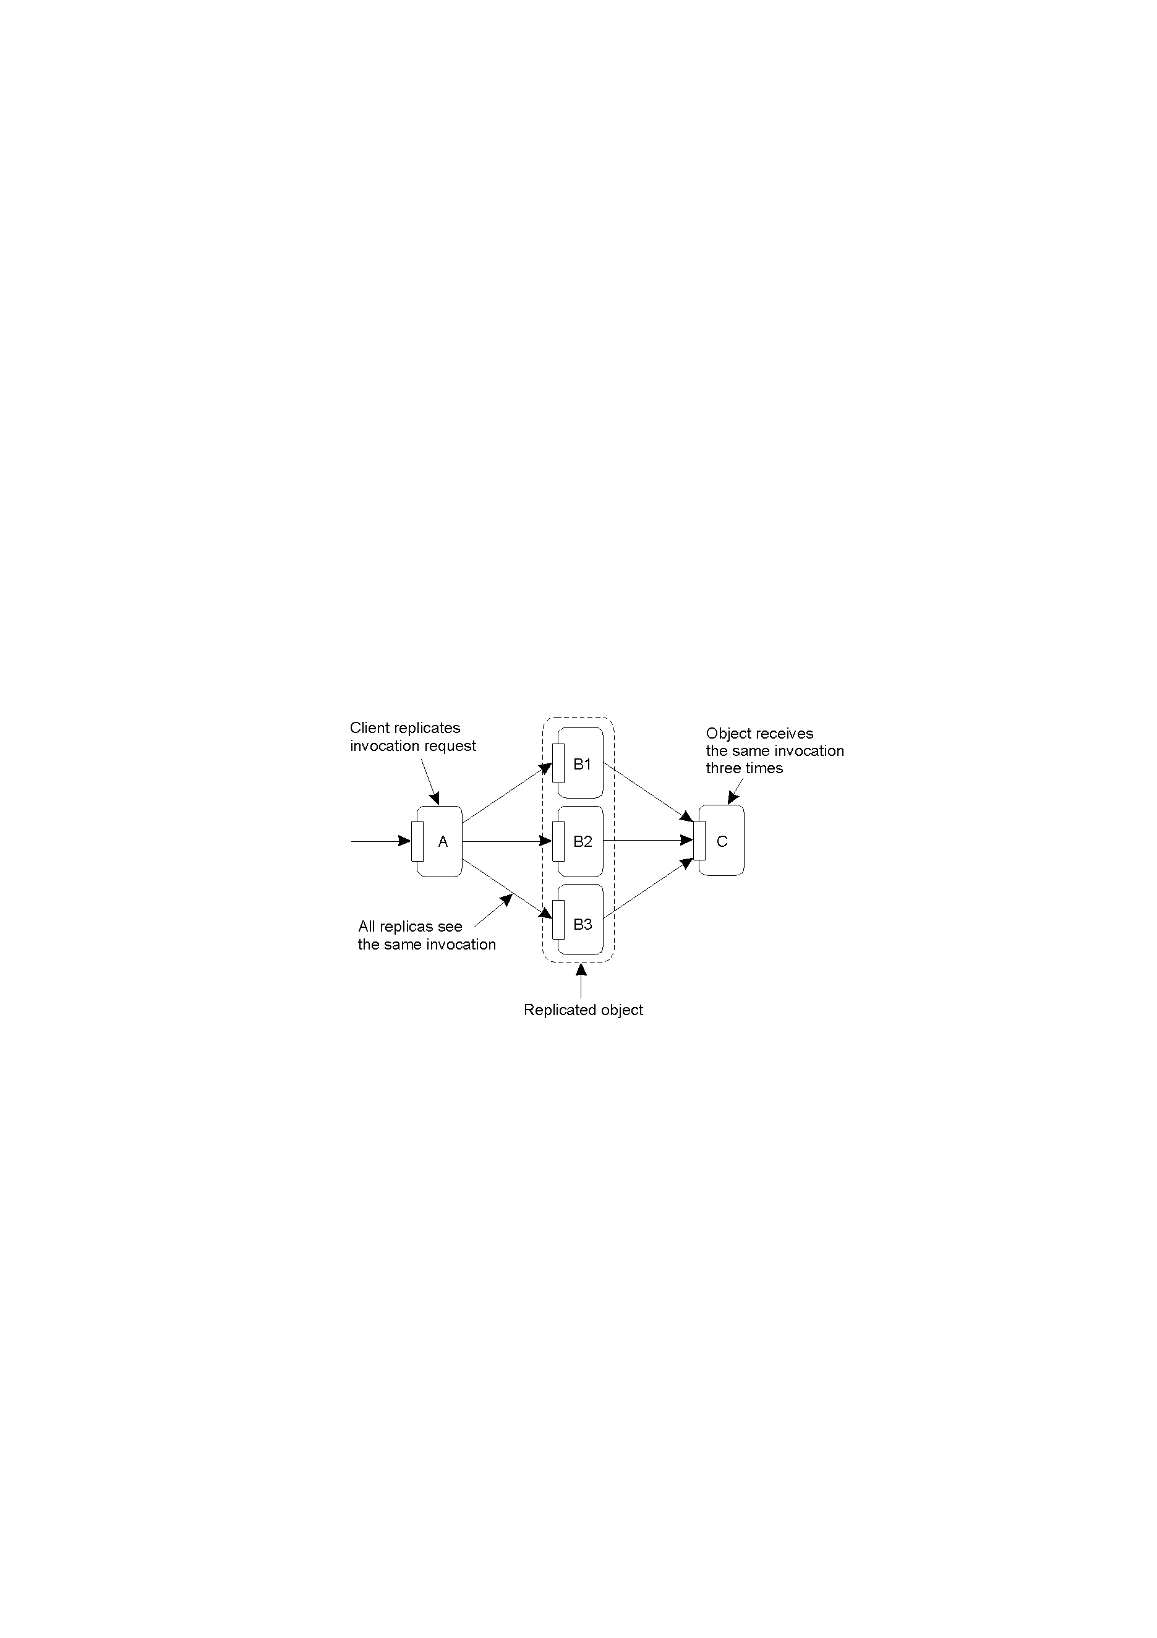
Replicated-Write Protocols: Active Replication (3)
The problem of replicated invocations.
avoid replicated invocations

Slide 37
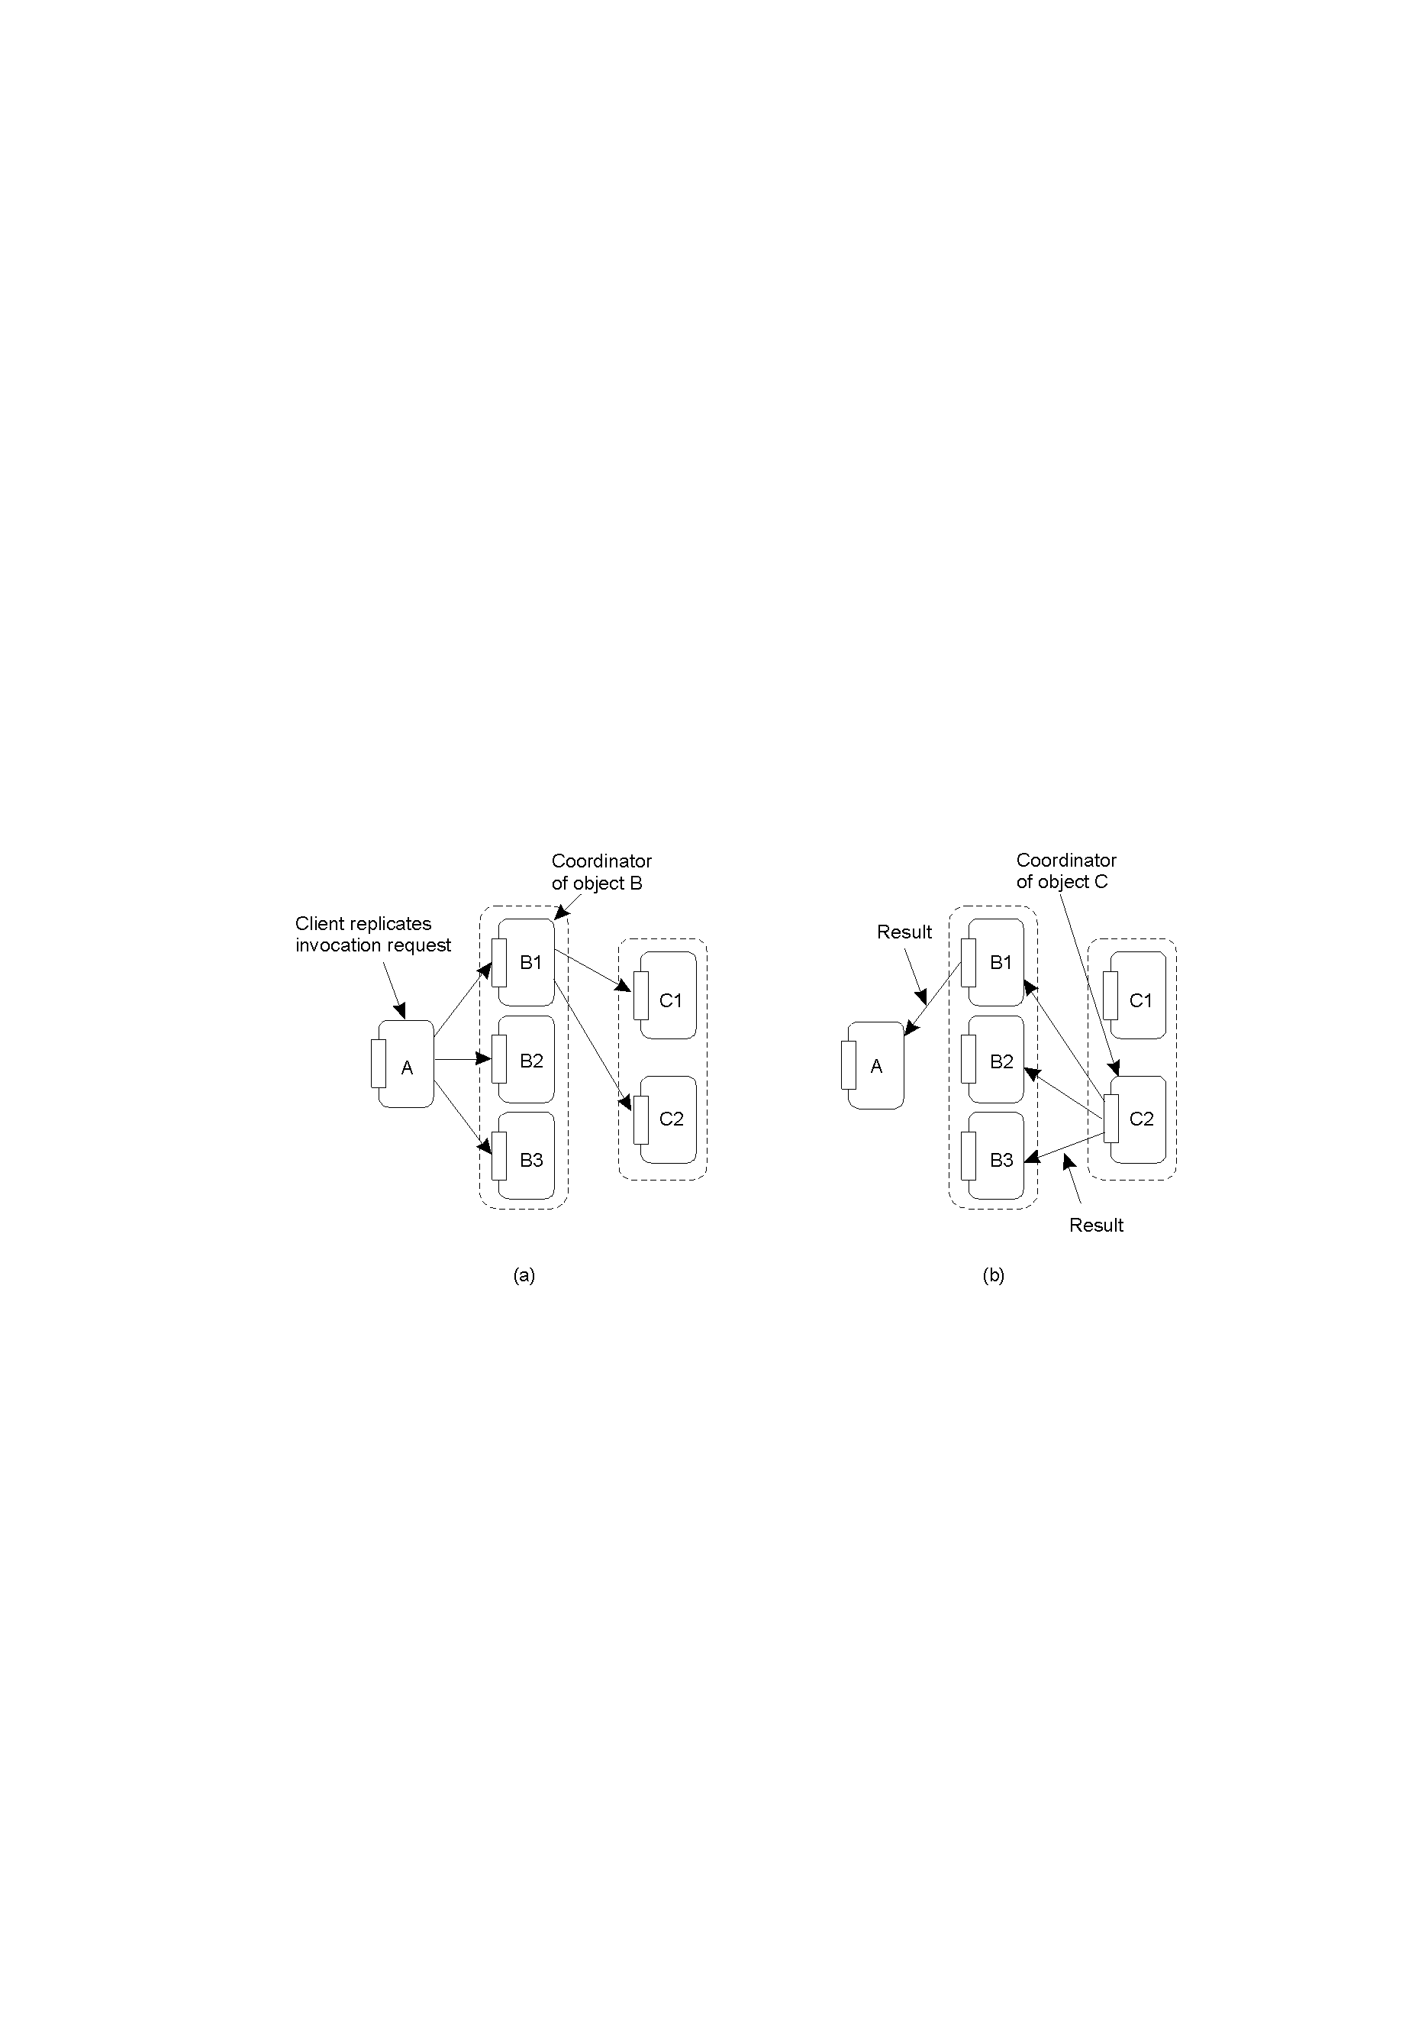
Replicated-Write Protocols: Active Replication (4)
How to deal with replicated invocation? Providing a replication-aware communication layer on top of which replicated objects execute.
Forwarding an invocation request from a replicated object.
Returning a reply to a replicated object.

Slide 38
Implementing fault-tolerant services via active replication
Fault-tolerant state machine:
Each server is a state machine whose state is modified by a client request. If their initial states are identical and all updates are delivered in the same total order (in spite of failures), then all correct replicas will always be in the same state.
The clients multicast updates to all the replica servers
Both client machines and replicas may fail
Clients never fail, only the replicas exhibit faulty behavior.
If the agreement and the order requirements are satisfied, we can get a fault-tolerant service

Slide 39
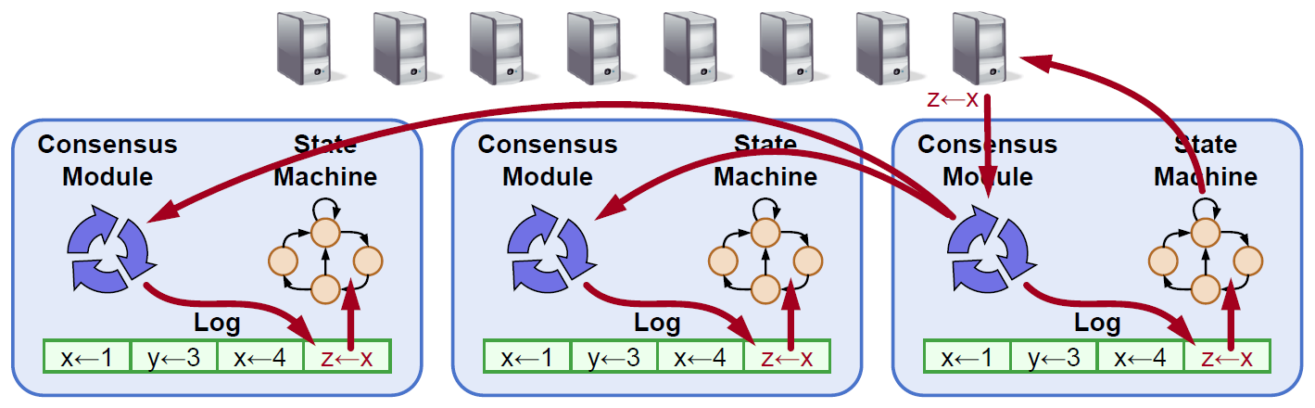
Replicated State Machine
Clients
Failure model: delayed/lost messages, fail-stop (not Byzantine)
Replicated log ensures state machines execute same commands in same order
Consensus module ensures the proper log replication
System makes progress as long as any majority of servers are up
Servers

Slide 40
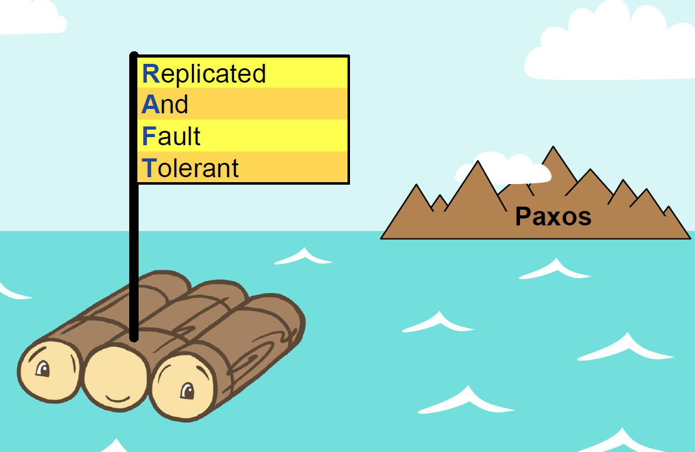
5.3 Raft: In Search of an Understandable Distributed Consensus
Leslie Lamport, Reed Benjamin, Junqueira Flavio, Diego Ongaro, John Ousterhout, Michael Olson, Keith Bostic, et al.
Best Paper of the 2014 USENIX Annual Technical Conference

Slide 41
Raft: An Understandable Distributed Consensus
Goal
Distributed consensus: Allows collection of machines to work as a coherent group, provides a continuous service, even if some machines fail
Understandability: Intuition, ease of explanation
Techniques
Problem decomposition: leader election, log replication (normal operations), safety (keep logs sequential consistency)
Minimize state space
Handle multiple problems with a single mechanism
Eliminate special cases
Maximize coherence
Minimize nondeterminism

Slide 42
Raft Basics: Server States and RPCs
start
discover
higher
term
… … … … … …
Passive(but expects
regular heartbeats)
Follower
discover current leader or new term
no heartbeat
Candidate
… … … … …
Issues RequestVote RPCs
to get elected as leader
time out
new election
win election
Issues AppendEntries RPCs:
Replicate its log
Heartbeats to main leadership
Leader
… … … ..

Slide 43
Raft Basics: Terms
Time is divided into terms
Each term begins with an election
At most 1 leader per term
Some terms have no leader (failed election)
Each server maintains current term value (no global view)
Exchanged in every RPC
Peer has a later term? Update term, revert to follower
Incoming RPC has obsolete term? Reply with error
Terms identify obsolete information
Term1 Term2 Term3 Term4 Term5
Elections Normal Operation Split Vote

Slide 44
Leader Election
Become candidate
currentTerm++,
Vote for self
timeout
Send RequestVote RPCs to other servers
Votes from majority
RPC from leader
Become leader,
Send heartbeats
Become follower

Slide 45
Election Correctness
Safety: allow at most one winner per term
Each server gives only one vote per term
Majority is required to win election
Liveness: some candidate must eventually win
Choose election timeouts randomly in [T, 2T] (e.g., 150-300 ms)
One server usually times out and wins election before others time out
Works well if T >> broadcast time
Randomized approach is simpler than ranking
B can’t also
get majority
Voted for candidate A

Slide 46
Normal Operation
Client sends a command to leader
Leader appends the command to its log
Leader sends AppendEntries RPCs to all followers
Once new entry is committed:
Leader executes command in its state machine, returns result to client
Leader notifies followers of committed entries in subsequent AppendEntries RPCs
Followers execute committed commands in their state machines
Crashed/slow followers?
Leader retries AppendEntries RPCs until they succeed
Optimal performance in common case:
One successful RPC to any majority of servers

Slide 47
Log Structure
Log Index
1 2 3 4 5 6 7 8 9 10
Term
1
x←3
1
q←8
1
j←2
2
x←q
2
z←5
3
y←1
3
y←3
3
q←j
3
x←4
3
z←6
Leader
Command
1
x←3
1
q←8
1
j←2
2
x←q
2
z←5
3
y←1
3
y←3
1
x←3
1
q←8
1
j←2
2
x←q
2
z←5
3
y←1
3
y←3
3
q←j
3
x←4
3
z←6
Followers
1
x←3
1
q←8
1
x←3
1
q←8
1
j←2
2
x←q
2
z←5
3
y←1
3
y←3
3
q←j
Committed
entries

Slide 48
Crashes can result in log inconsistencies
1 2 3 4 5 6 7 8 9 10
Raft minimizes special code for repairing inconsistencies:
Leader assumes its log is correct
Normal operation will repair all inconsistencies
1
x←3
1
q←8
1
j←2
2
x←q
2
z←5
3
y←1
3
y←3
3
q←j
Leader
1
x←3
1
q←8
1
j←2
2
x←q
2
z←5
3
y←1
3
y←3
1
x←3
1
q←8
1
j←2
2
x←q
2
z←5
3
y←1
3
y←3
3
q←j
3
x←4
Followers
1
x←3
1
q←8
1
x←3
1
q←8
1
j←2
2
x←q
2
z←5
2
y←3
2
q←j
2
x←8
2
x←4

Slide 49
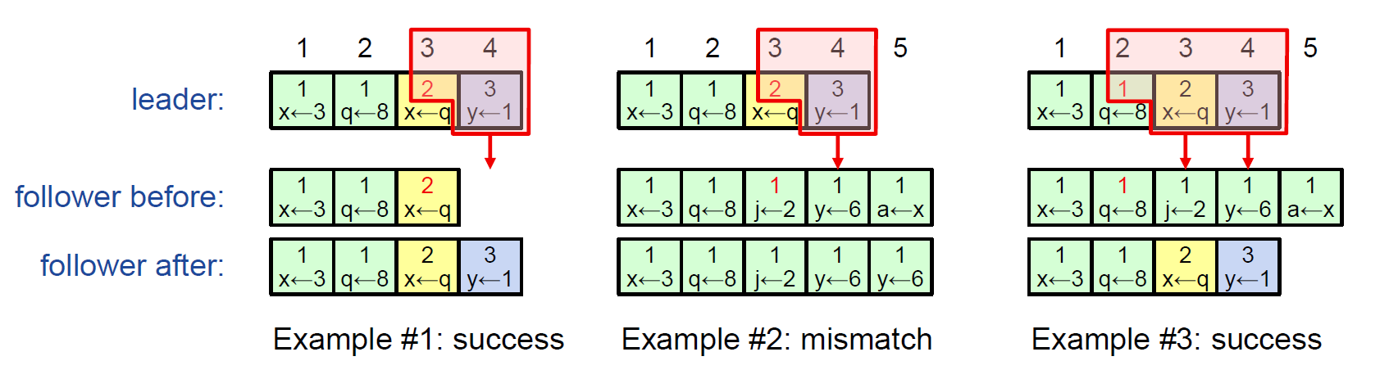
AppendEntries Consistency Check
AppendEntries RPCs include <index, term> of entry preceding new one(s)
Follower must contain matching entry; otherwise it rejects request
Leader retries with a lower log index
Implements an induction step, ensures Log Matching Property

Slide 50
Raft Property
Election Safety: at most one leader can be elected in a given term
Leader Append-Only: a leader never modifies or deletes entries in its log
Log Matching: if two logs contain an entry with the same index and term, then the logs are identical in all entries up through the given index
Leader Completeness Safety: if a log entry is committed, then that entry will be present in the logs of all future leaders
State Machine Safety: if a server has applied a log entry at a given index to its state machine, no other server will ever apply a different log entry for the same index

Slide 51
Leader Completeness Safety
Once a log entry is committed, all future leaders must store that entry
Servers with incomplete logs must not get elected:
Candidates include index and term of last log entry in RequestVote RPCs
Voting server denies vote if its log is more up-to-date
Logs ranked by <lastTerm, lastIndex>

Slide 52
5.4 A Naïve Implementation of Client-Centric Consistency
客户保留两个写标识符集合，每个写操作的标识符由执行写的服务器给出：
客户的读集合Rset：由这个客户执行的读操作相关的写标识符组成
客户的写集合Wset：由这个客户执行的写操作的标识符组成
(Monotonic-Read Consistency)客户要在一个服务器上执行一个读操作
服务器去检查客户的读集合，即，检查是否所有所标识的写操作已在本地执行。如果没有，那么，(*)该服务器和其他服务器交互，确保该服务器在做读操作之前，将数据更新到最新；或者(*)将读操作传递到一个已发生了写操作的服务器上
在读操作完成之后，那些与读操作有关的、在所选中服务器上执行的写操作的标识符，都被加入到客户的读集合中

Slide 53
A Naïve Implementation of Client-Centric Consistency (2)
(Monotonic-Writes Consistency) 客户要在一个服务器上执行一个写操作
服务器先检查客户传递来的写集合，确保所标识的写操作要先完成，然后执行这个写操作
在完成写操作后，该操作的写标识符被加入到这个客户的写集合
(Read Your Writes Consistency) 在服务器执行读操作之前，找到一个已执行完那些写操作的服务器，从它那里取得那些写操作的结果
(Writes Follow Reads Consistency) 在服务器执行写操作前，让服务器先得到客户的读集合，把读集合中的写操作都执行一遍，然后执行写操作，然后把写操作的标识符加入写集合，同时，把读集合的标识符加入到写集合中

Slide 54
改进读集合和写集合的表示方法
缩短读集合、写集合的生命周期，把客户的读操作、写操作按照应用语义分成一个个会话，会话结束，读集合、写集合被清空
服务器S_{i}：WVC_{i}记录服务器S_{i}收到和处理的写操作的时间戳，其中WVC_{i}[j]是由服务器S_{j}发出的、由S_{i}接收和处理的最近的写操作的时间戳
客户：用向量时间戳表示读集合和写集合。为每个会话A，构造向量时间戳SVC_{A}，会话时间戳反映了客户看到的已经作为会话一部分执行的最新的写操作。也就是说，可以用一个时间戳表示所有来自同一个服务器的客户看见的写操作
SVC_{A}[j] = max { timestamp(W) | W∈ A && origin(W)=S_{j} }
如果 SVC_{A} [j] > WVC_{i}[j]，那么，S_{i}还没有看到客户已经看到的源于S_{j}的写操作
用法：客户在会话A中登录服务器S_{i}，它把SVC_{A}传递给S_{i}。服务器S_{i}执行完写操作后，S_{i}将更新它当前的时间戳WVC_{i}。然后，客户的SVC_{A}将被更新：
SVC_{A}[j] = max {SVC_{A}[j], WVC_{i}[j]}

